Slide 1


Strategic Insights for Film Studio Success
Data-Driven Decisions for High Box Office Performance
GROUP 3

Slide 2

Business Objective
  Launch a profitable movie studio by identifying high-performing genres, budget strategies, and audience engagement trends.
  Leverage insights for competitive entry into the film industry.

Slide 3
Industry Opportunity
Why Now?
Global box office revenue is rebounding and expected to grow to $50 billion by 2030.
High ROI from specific genres like low-budget horror (200–300% ROI).
Increased importance of IMDb ratings and audience engagement in driving revenue.

Slide 4
Key Business Questions
  Which genres and themes lead to high box office performance?
  How do production budgets influence profitability and ROI?
  What impact do ratings and audience engagement have on success?
  How does revenue split between domestic and international markets across genres?
  When is the best time to release films?

Slide 5
Data Overview
  IMDb: Movie Basics
    Key variables: genres, runtime, release year.
    Addresses Q1 and Q5.
  IMDb: Movie Ratings
    Key variables: average rating, votes.
    Addresses Q3.
  The Numbers: Budget Data
    Key variables: production budget, domestic and worldwide gross.
    Addresses Q2 and Q4.
  TMDb: Metadata
    Key variables: language, release date, audience votes.
    Addresses Q3.

Slide 6
Methodology
  Overview of datasets combined for analysis:
    IMDb (movie_basics, movie_ratings).
    TMDb (genre_ids, language, votes).
    TN Budget (budget and revenue).
  Steps in cleaning, merging, and analyzing data.

Slide 7
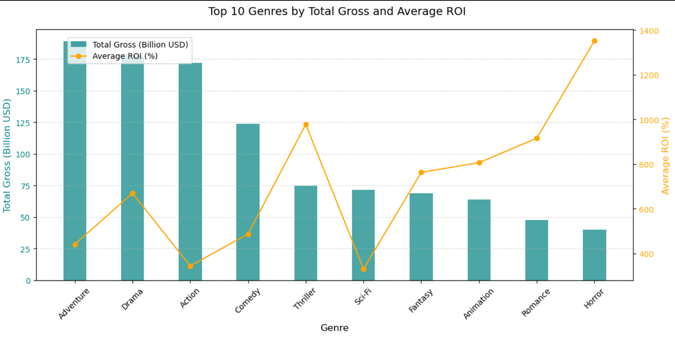
Insights on Genres and Themes
High-Performing Genres
  Action, superhero, and adventure dominate the box office (70% revenue in 2023).
  Low-budget horror films provide high ROI.

Slide 8
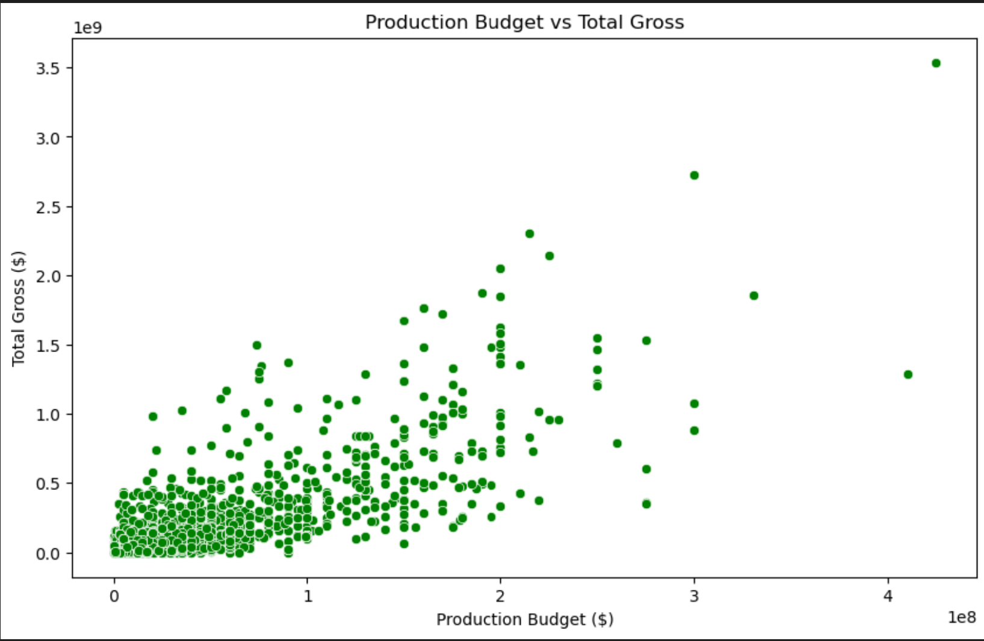
Budget Insights
Budget vs. Profitability
  Relationship between production budgets and ROI.
  Identification of optimal budget ranges for profitability.

Slide 9
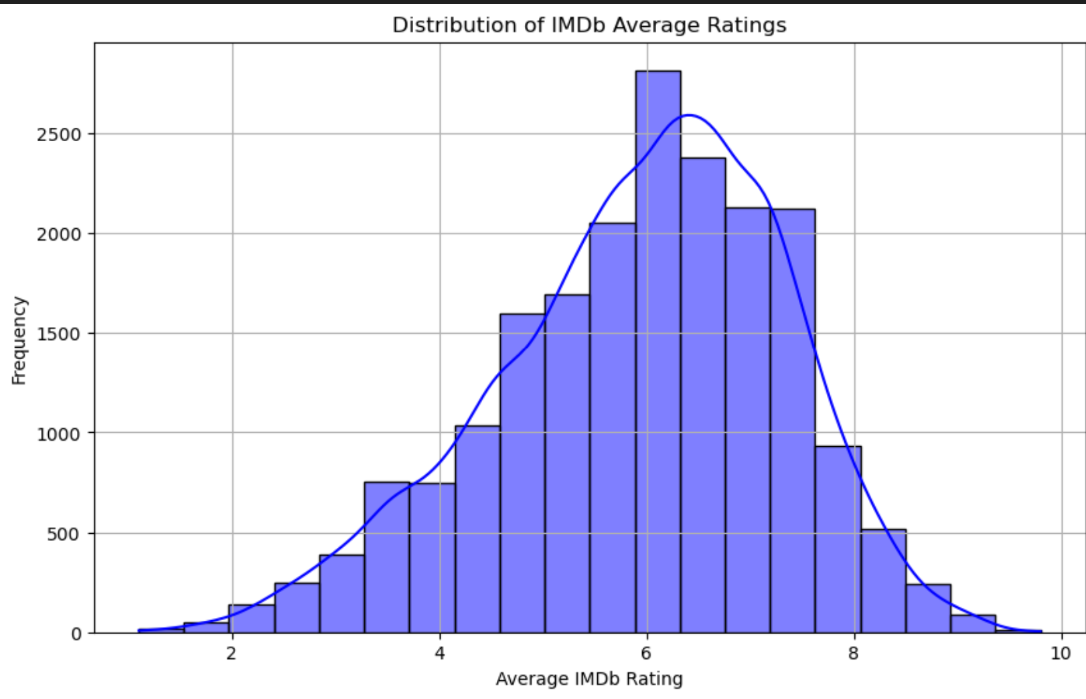
Audience Engagement
Impact of Ratings and Engagement
  Movies with IMDb ratings >7.5 earn 40% more revenue.
  Engagement metrics (e.g., votes) correlate with higher box office performance.

Slide 10
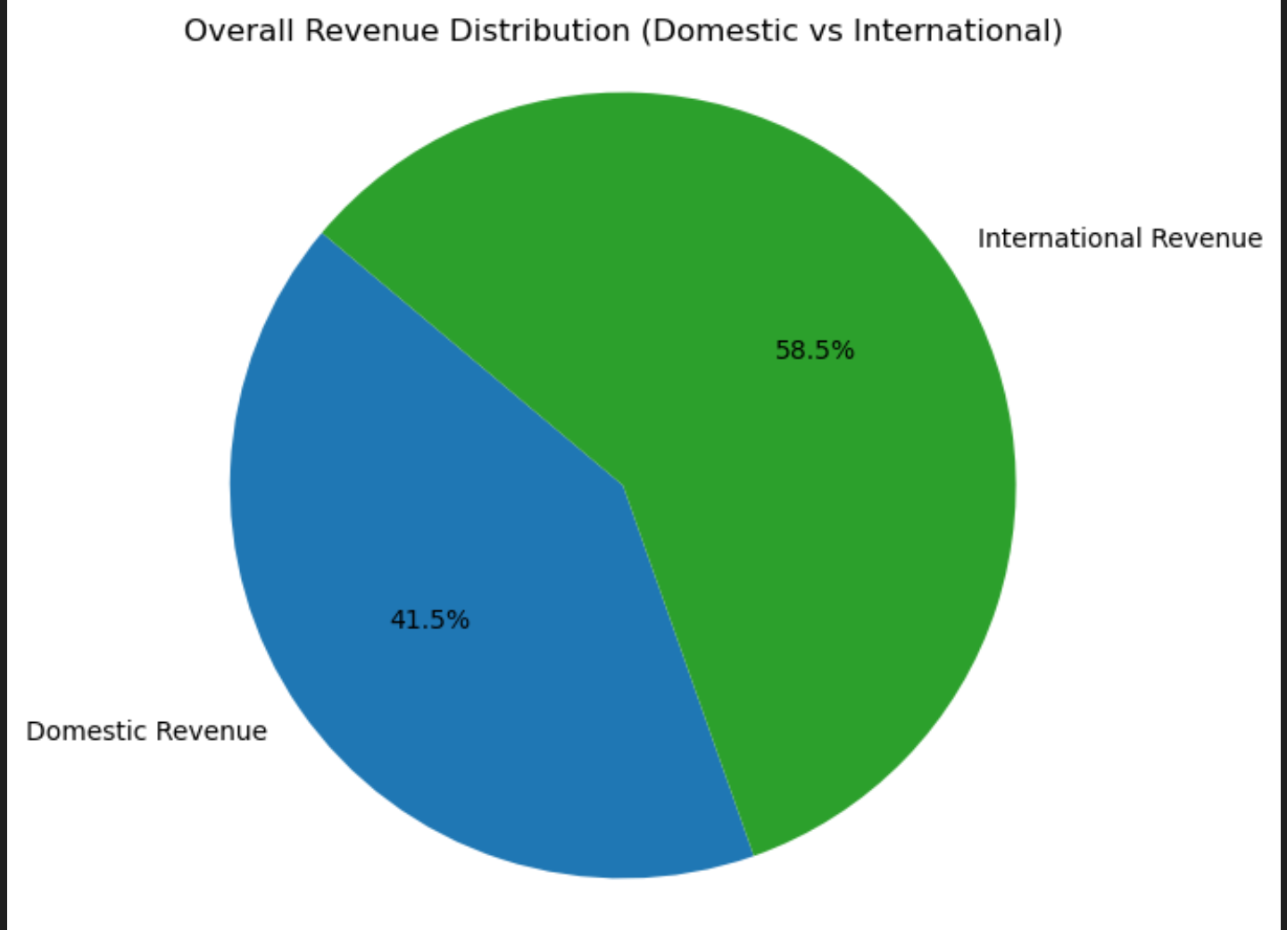
Revenue Composition
Domestic vs. International Revenue
  Analysis of revenue splits for various genres and film types.

Slide 11
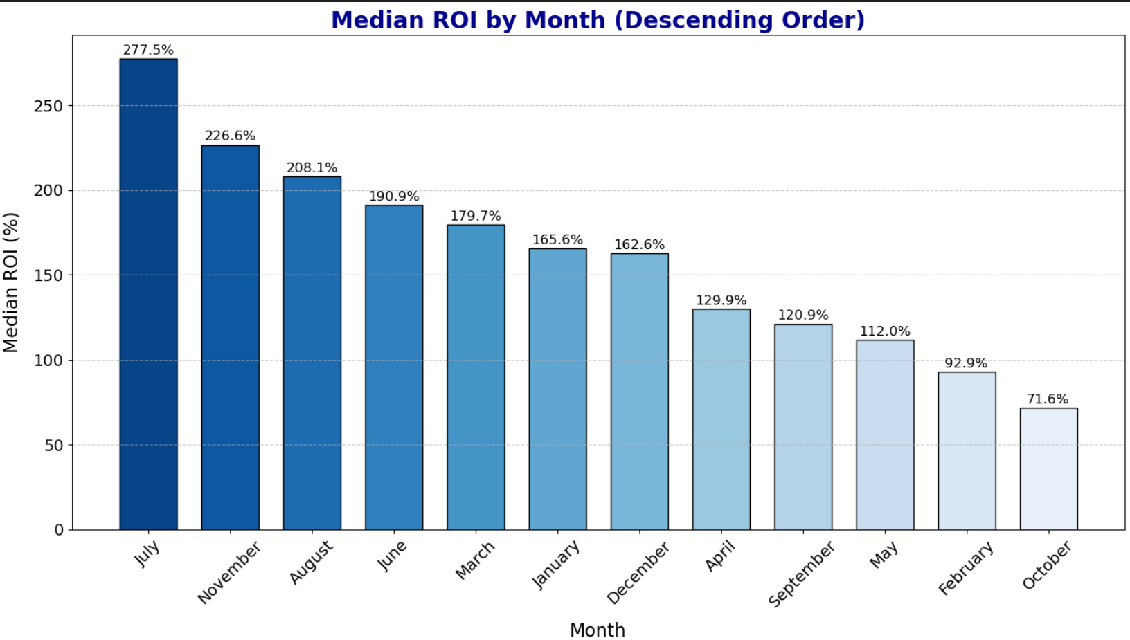
Release Timing
Optimal Release Windows
  Insights into seasonal trends and high-revenue months/quarters.

Slide 12
Strategic Recommendations
  Focus on high-ROI genres.
  Allocate budgets strategically within identified profitable ranges.
  Leverage audience engagement strategies.
  Prioritize international markets for specific genres.
  Target strategic release windows for maximizing returns.

Slide 13
Q & A

